Slide 1

Cloud Computing

Slide 2


What is Cloud Computing
APPLICATION & DATA
SOFTWARE
SERVERS & STORAGE
NETWORK

Slide 3
What is Cloud Computing
allows us to create, configure, and customize applications via an internet
allows us to store, manage, and access data online rather than local drives

Slide 4
What can be done using Cloud Computing
Developing new applications and services
Storage, back up, and recovery of data
Hosting blogs and websites
Delivery of software on demand
Analysis of data
Streaming videos and audios
etc ….

Slide 5
History of Cloud Computing
1961, John MacCharty suggested in a speech at MIT that computing can be sold like a utility, just like a water or electricity
1999, Salesforce.com
2002, Amazon AWS
2009, Google Apps
2009, Microsoft Azure
Oracle and HP have all joined the game
Today, cloud computing has become mainstream.

Slide 6
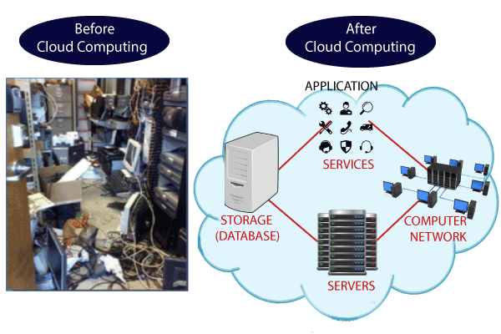
Why Cloud Computing?

Slide 7
Why Cloud Computing?
Traditional Method
Cloud Computing
Server Room | database server, mail server, networking, firewalls, routers, modem, switches, the maintenance engineers etc..
reduce the IT infrastructure cost
spend lots of money

Slide 8
Characteristics of Cloud Computing
Elasticity | Computational capacity increases and decreases automatically based on requirement
Services in the pay-per-use mode | APIs are provided to the users so that they can access services on the cloud by using these APIs and pay the charges as per the usage of services
Agility | It shares resources among users and works very fast
High availability and reliability | Availability of servers is high and more reliable because the chances of infrastructure failure are minimum
High Scalability | Cloud offers "on-demand" provisioning of resources on a large scale, without having engineers for peak loads

Slide 9
Characteristics of Cloud Computing
Multi-Sharing | Multiple users and applications can work more efficiently with cost reductions by sharing common infrastructure.
Device and Location Independence | As infrastructure is off-site and accessed via the Internet, users can connect from anywhere.
Maintenance | Maintenance of applications is easier, since they do not need to be installed on each user's computer and can be accessed from different places
Low Cost | IT company need not to set its own infrastructure and pay-as-per usage of resources.

Slide 10
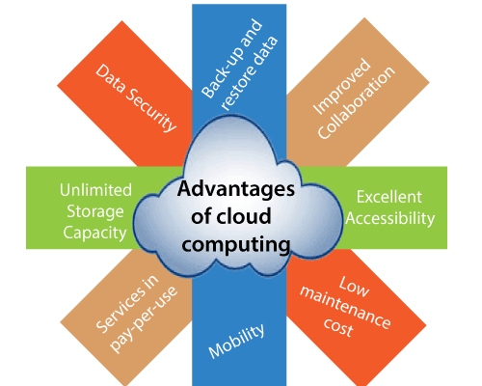
Advantages of Cloud Computing

Slide 11
Advantages of Cloud Computing
Back-up and restore data | Once the data is stored in the cloud, it is easier to get back-up and restore that data using the cloud.
Improved collaboration | Cloud applications improve collaboration by allowing groups of people to quickly and easily share information in the cloud via shared storage.
Excellent accessibility | Cloud allows us to quickly and easily access store information anywhere, anytime in the whole world, using an internet connection
Low maintenance cost | Cloud computing reduces both hardware and software maintenance costs for organizations.

Slide 12
Advantages of Cloud Computing
Mobility | Cloud computing allows us to easily access all cloud data via mobile.
pay-per-use model | Cloud computing offers APIs to the users for access services on the cloud and pays the charges as per the usage of service.
Unlimited storage capacity | Cloud offers us a huge amount of storing capacity for storing our important data in one place.
Data security | Cloud offers many advanced features related to security and ensures that data is securely stored and handled.

Slide 13
Disadvantages of Cloud Computing
Internet | If you do not have good internet connectivity, you cannot access these data. However, we have no any other way to access data from the cloud.
Vendor lock-in | Organizations may face problems when transferring their services from one vendor to another. As different vendors provide different platforms, that can cause difficulty moving from one cloud to another.
Limited Control | cloud infrastructure is completely owned, managed, and monitored by the service provider, so the cloud users have less control over the function and execution of services within a cloud infrastructure.
Security | While sending the data on the cloud, there may be a chance that your organization’s sensitive information is hacked by Hackers.

Slide 14
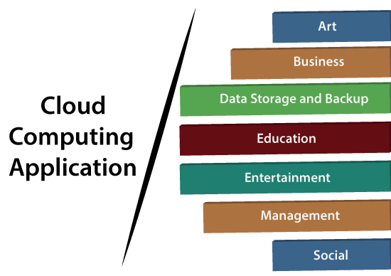
Cloud Computing Applications

Slide 15
Cloud Computing Applications
Art Application
Vistaprint
Moo
Adobe Creative Cloud

Slide 16
Cloud Computing Applications
Salesforce
Business Application
MailChimp
Chatter
Paypal
Bitrix24
Slack
Quickbooks

Slide 17
Cloud Computing Applications
Box.com
Data Storage & backup Application
Google G Suite
Joukuu
Mozy

Slide 18
Cloud Computing Applications
Education Application
Google Apps
AWS

Slide 19
Cloud Computing Applications
Entertainment Application
Online games
Video Conferencing

Slide 20
Cloud Computing Applications
Management Application
Toggl
Evernote
Outright
GoToMeeting

Slide 21
Cloud Computing Applications
Social Application
Facebook
Twitter
Yammer
LinkedIn

Slide 22
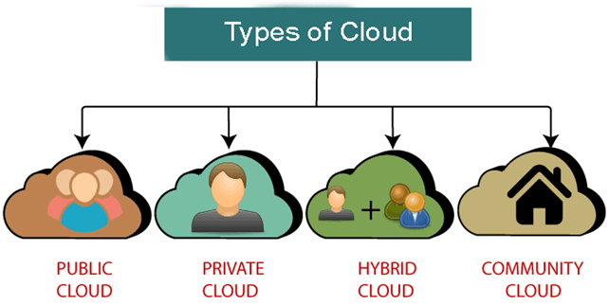
Types of Cloud Types of Cloud

Slide 23
Public Cloud
provides a shared platform that is accessible to the general public through an Internet
operated on the pay-as-per-use model and administrated by the Cloud service provider
same storage is being used by multiple users at the same time
owned, managed, and operated by businesses, universities, government organizations, or a combination of them

Slide 24
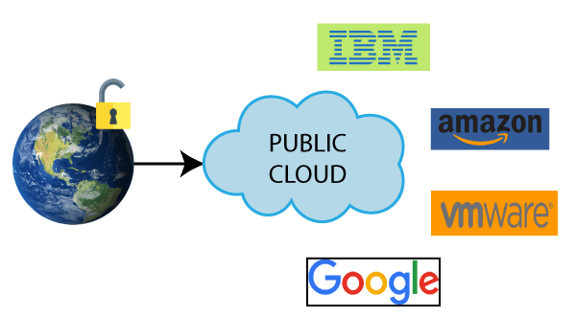

Public Cloud Service Provider
etc

Slide 25
Advantages of Public Cloud
Business Agility | provides an ability to elastically re-size computer resources based on the organization's requirements.
Location Independent | location independent because its services are offered through the internet.
Save Time | cloud service provider is responsible for the manage and maintain data centers so the user can save their time to establish connectivity, deploying new products, assemble servers etc.
Quickly and easily set up | Organizations can easily buy public cloud on the internet and deployed and configured it remotely.
Scalability and reliability | offers scalable and reliable (24*7 available) services to the users.
Low Cost | lower cost than private, or hybrid cloud, as it shares the same resources with a large number of consumers.

Slide 26
Disadvantages of Public Cloud
Low Security | less secure because resources are shared publicly.
Performance | performance depends upon the speed of internet connectivity.
Less customizable | less customizable than the private cloud.

Slide 27
Private Cloud
known as an internal cloud or corporate cloud.
provides computing services within the organization instead of the general public.
provides a high level of security and privacy to data through firewalls and internal hosting. It also ensures that operational and sensitive data are not accessible to third-party providers.
owned, managed, and operated by businesses, universities, government organizations, or a combination of them
HP Data Centers, Microsoft, Elastra-private cloud, and Ubuntu are some examples

Slide 28
Advantages of Private Cloud
More Control | more control over their resources and hardware than public clouds because it is only accessed within organization.
Security & privacy | one of the big advantages over public cloud.
Improved performance | better performance with improved speed and space capacity.

Slide 29
Disadvantages of Private Cloud
High cost | The cost is higher than a public cloud because set up and maintain hardware resources are costly.
Restricted area of operations | accessible within the organization, so the area of operations is limited.
Limited scalability | are scaled only within the capacity of internal hosted resources.

Slide 30
Hybrid Cloud
combination of public and private clouds.
main aim to combine Public and Private cloud is to create a unified, automated, and well-managed computing environment.
non-critical activities are performed by the public cloud and critical activities are performed by the private cloud.
Mainly, a hybrid cloud is used in finance, healthcare, and Universities.
hybrid cloud provider companies are Amazon, Microsoft, Google, Cisco, and NetApp.

Slide 31
Advantages of Hybrid Cloud
Flexible and secure | provides flexible resources because of the public cloud and secure resources because of the private cloud.
Cost effective | offers the features of both the public as well as the private cloud. It helps organizations to save costs for both infrastructure and application support.

Slide 32
Disadvantages of Hybrid Cloud
Networking issues | networking becomes complex because of the private and the public cloud.
Infrastructure Compatibility | with dual-levels of infrastructure, a private cloud controls the company, and a public cloud does not, so there is a possibility that they are running in separate stacks.
Reliability | The reliability of the services depends on cloud service providers.

Slide 33
Community Cloud
allows systems and services to be accessible by a group of several organizations to share the information.
owned, managed, and operated by one or more organizations in the community, a third party, or a combination of them.
Example: Our government organization within India may share computing infrastructure in the cloud to manage data.

Slide 34
Advantages of Community Cloud
Cost effective | the whole cloud is shared between several organizations or a community.
Flexible and Scalable | allows the users to modify the documents as per their needs and requirement.
Security | more secure than the public cloud but less secure than the private cloud.
Sharing infrastructure | allows us to share cloud resources, infrastructure, and other capabilities among various organizations.

Slide 35
Disadvantages of Community Cloud
not a good choice for every organization.
Slow adoption to data.
The fixed amount of data storage and bandwidth is shared among all community members.
costly than the public cloud.
Sharing responsibilities among organizations is difficult.

Slide 36
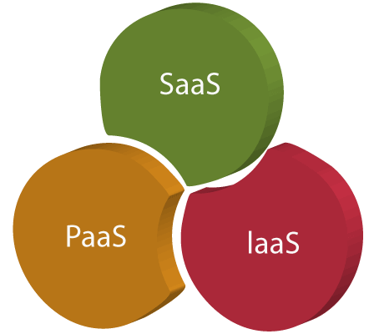
Cloud Service Models

Slide 37
IaaS
IaaS or Infrastructure as a Service
allows customers to outsource their IT infrastructures such as servers, networking, processing, storage, virtual machines, and other resources.
eliminates the need for every organization to maintain the IT infrastructure.
clients can dynamically scale the configuration to meet changing requirements and are billed only for the services actually used.

Slide 38
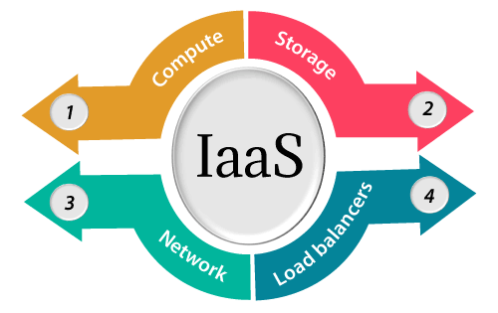
IaaS

Slide 39
Services provided by IaaS
Compute | Computing as a Service includes virtual central processing units and virtual main memory for the VMs that is provisioned to the end-users.
Storage | IaaS provider provides back-end storage for storing files.
Network | Network as a Service (NaaS) provides networking components such as routers, switches for the VMs
Load balancer | It provides load balancing capability at the infrastructure layer.

Slide 40
Advantages of IaaS
Shared infrastructure | allows multiple users to share the same physical infrastructure.
Web access to the resources | allows IT users to access resources over the internet.
Pay-as-per-use model | IaaS providers provide services based on the pay-as-per-use basis. The users are required to pay for what they have used.
On-demand scalability | Avail as per requirement. Using IaaS, users do not worry about to upgrade software and troubleshoot the issues related to hardware components.

Slide 41
Disadvantages of IaaS
Security | Security is one of the biggest issues in IaaS. Most of the IaaS providers are not able to provide 100% security.
Interoperability issues | It is difficult to migrate VM from one IaaS provider to the other, so the customers might face problem related to vendor lock-in.

Slide 42
PaaS
PaaS or Platform as a Service provides a runtime environment
allows programmers to easily create, test, run, and deploy web applications
back end scalability is managed by the cloud service provider, so end-users do not need to worry about managing the infrastructure

Slide 43
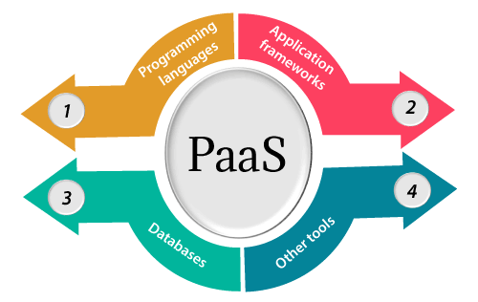
PaaS

Slide 44
Services provided by PaaS
Programming languages | PaaS providers provide various programming languages for the developers to develop the applications.
Application frameworks | PaaS providers provide application frameworks to easily understand the application development. Some popular application frameworks are Node.js, Drupal, Joomla, etc.
Databases | PaaS providers provide various databases such as PostgreSQL, MongoDB etc. to communicate with the applications.
Other tools | PaaS providers provide various other tools that are required to develop, test, and deploy the applications.

Slide 45
Advantages of PaaS
Simplified Development | PaaS allows developers to focus on development and innovation without worrying about infrastructure management.
Prebuilt business functionality | Some PaaS vendors also provide already defined business functionality so that users can avoid building everything from very scratch and hence can directly start the projects only.
Scalability | Applications deployed can scale from one to thousands of users without any changes to the applications.

Slide 46
Disadvantages of PaaS
Vendor lock-in | One has to write the applications according to the platform provided by the PaaS vendor, so the migration of an application to another PaaS vendor would be a problem.
Data Privacy | Corporate data, whether it can be critical or not, will be private, so if it is not located within the walls of the company, there can be a risk in terms of privacy of data.

Slide 47
SaaS
SaaS or Software as a Service is also known as "On-Demand Software".
software distribution model in which services are hosted by a cloud service provider.

Slide 48
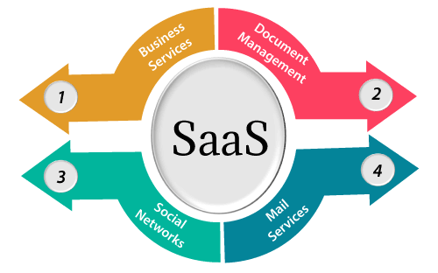
SaaS

Slide 49
Services provided by SaaS
Business Services | SaaS business services include ERP (Enterprise Resource Planning), CRM (Customer Relationship Management), billing, sales.
Document Management | SaaS document management is a software application to create, manage, and track electronic documents.
Social Networks | social networking service providers use SaaS for their convenience and handle the general public's information.
Mail Services | To handle the unpredictable number of users and load on e-mail services, many e-mail providers offering their services using SaaS.

Slide 50
Advantages of SaaS
easy to buy | SaaS pricing is based on a monthly fee/annual fee subscription, so it allows you to access business functionality at a low cost, which is less than licensed applications.
No special software or hardware versions required | All users will have the same version of the software and typically access it through the web browser.
Less hardware | The software is hosted remotely, so organizations do not need to invest in additional hardware.
Low maintenance | SaaS removes the need for installation, set-up, and daily maintenance for the organizations.

Slide 51
Disadvantages of SaaS
Latency issue | Since data and applications are stored in the cloud at a variable distance from the end-user, there is a possibility that there may be greater latency when interacting with the application compared to local deployment. Therefore, the SaaS model is not suitable for applications whose demand response time is in milliseconds.
Switching between SaaS vendors is difficult | Switching SaaS vendors involves the difficult and slow task of transferring the very large data files over the internet and then converting and importing them into another SaaS also.

Slide 52
IaaS | Paas | SaaS
It provides a virtual data center to store information and create platforms for app development, testing, and deployment | It provides virtual platforms and tools to create, test, and deploy apps | It provides web software and apps to complete business tasks
It provides access to resources such as virtual machines, virtual storage, etc | It provides runtime environments and deployment tools for applications | It provides software as a service to the end-users
It is used by network architects | It is used by developers | It is used by end users
IaaS provides only Infrastructure | PaaS provides Infrastructure + Platform | SaaS provides Infrastructure + Platform + Software

Slide 53
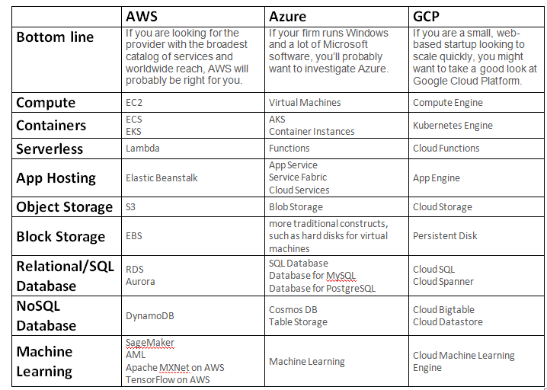

Slide 54
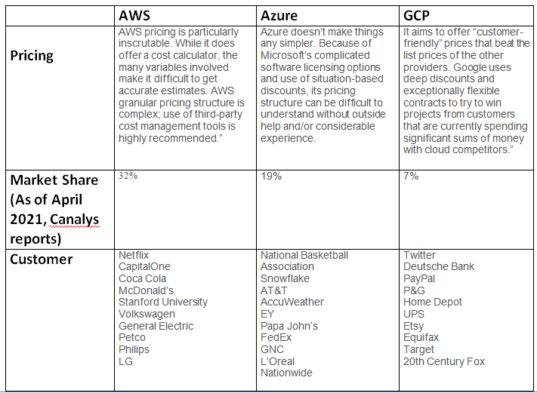

Slide 55
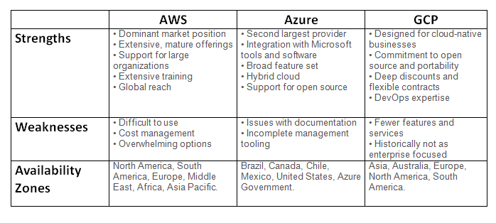

Slide 56
